Slide 1

Team ID: 29503
Team Name: TechCoders
No. of Members: 5
Team Leader Name: Aditi Prusty
Problem Statement ID: DR717

Slide 2

Details of all Team Members
SN | Team Member Name | Role | College Passing Year
1 | Aditi Prusty | Team Leader, front-end, PPTs making, team coordination | 2025
2 | Sudeepta Giri | Front-end, back-end support | 2025
3 | Nihar Ranjan Sahu | Back-end, front-end support | 2025
4 | Twinkle | Data collection, finding important links | 2025
5 | Subhraja Sahoo | Data compilation, PDFs making | 2025

Slide 3
Idea Description (5 to 6 lines)
Our solution to the problem statement is that if our website is approved, then all the Indian Universities will have to follow the same and one single academic calendar, whose dates and all the other information will be given by AICTE, and all the universities will be bound to follow that. this will help the students throughout the country to plan their academic year well ahead in time and in an efficient way, irrespective of the difference in place or what university it is.
The website's landing page has 3 user interfaces, one for AICTE(Super-admin), one for the Universities and Colleges(Admin), and one for the Users or the students. They will then have access to the calendar displaying the information and tabulated information that will be displayed, also the access to other useful links. The Super-admin and Admins will have their other rights once they login using their credentials.

Slide 4
Innovative Idea Solution (50 Words)
All the details regarding the holidays, semester breaks of Indian Universities.
A “Stream” option is made available to choose a stream or a course based on your selected preferences.
Academic calendar schedules will be displayed separately for every stream, based on the selection.
Detailed year wise course details and their dates are provided in separate PDFs for every branch and course.
Log in/Register options are made available for universities or administrators. Once their authentication is verified, they will be given access to add or modify further details in the academic calendar for their respective universities.
Our site lists up every key date of classes, exams, events, and semester breaks.

Slide 5
Reference Architecture / Solution Architecture (50 Words)
We have built our approach to the solution keeping in mind about the issues which are faced by students like us, and our solution will help the students in future.
For reference of how an academic calendar should look like, and what details an academic calendar shall contain, we visited academic calendar websites of few universities and colleges.

Slide 6
Technology Stack
HTML
CSS
JAVASCRIPT
PHP
MySQL Database

Slide 7
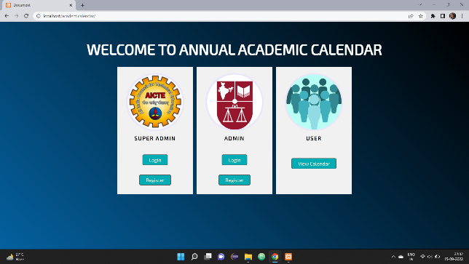
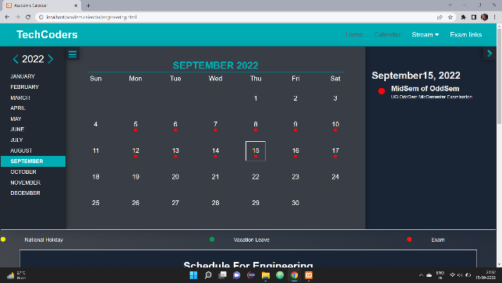
Images / Screenshots of the working prototype

Slide 8
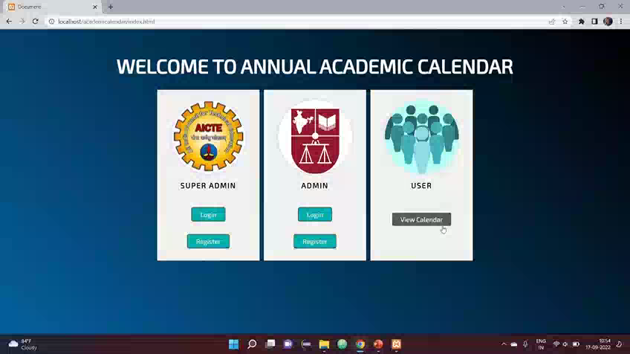
Video of Working Prototype (High resolution - <1min)

Slide 9
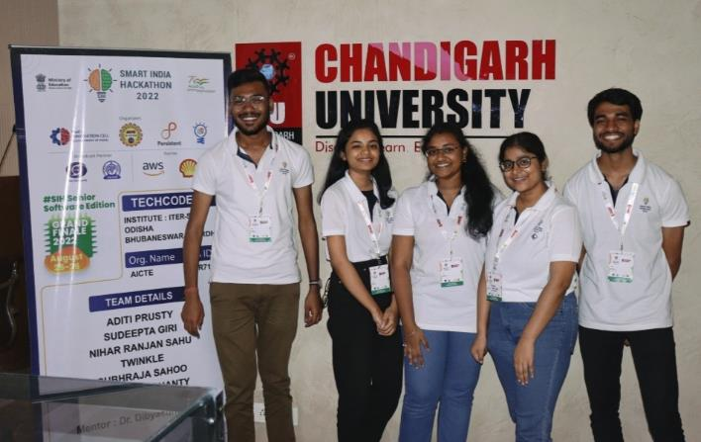
Group Picture of all Participants with Developed Prototype (High Resolution) (If possible in SIH Tee-shirts)

